Slide 1
9. Group Theory
Group in Physics and chemistry Point Group
Symmetry of electronic states and vibration
Symmetry group and rotational groups

Slide 2
Symmetry appeared in physics and chemistry
Symmetry of molecule or unit cell $⇒$ Point Group : G_{P}
G_{P} consists of rotation, mirror and inversion
If Hamiltonian belongs to a G_{P}, wavefunctions and oscillation are representation of G_{P}
Translational symmetry $⇒$ Space Groups : G_{S}
G_{S} consist of translation spiral $⇒$ Crystal structure analysis
Rotation of Molecule, spin $⇒$ Rotational Groups : G_{R}
G_{R} consist of rotation (spherical symmetry)
Rotation angle = 30⁰, 45⁰, 60⁰ $⇒$ G_{P}
N equivalent electrons or spin $⇒$ Symmetry Group : S_{N}
S_{N} consists of N ! Permutations
Slater determinant, many body problem

Slide 3
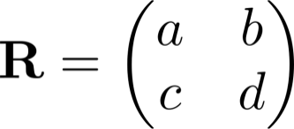
Element of A Groups
Symmetry operation : R $⇒$ operation that doesn’t change shape.
$Cn$ : $n$-fold rotation $i$ : inversion $σ$ : mirror
Products of operations $⇒$ Definition of group
Representation : C $⇒$ Objects applied by R (wave function)
Sign of C changes. (1D Rep.)
changes within
Example :
in general :
Representation Space :
Space unchanged by all R’s in G
Space should be closed $⇒$ we solve the problem in a small space
Basis set constructing S (ex. Unit vector ) $⇒$R depends on basis set
n dimension
n x n representation matrix

Slide 4
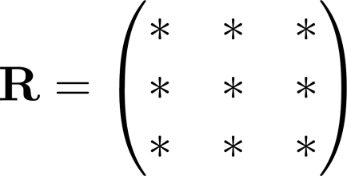
Example of Representation of Group
Rotation in 3D $⇒$ Product of
Scalar variable $⇒$ invariant under rotation → 1 D Rep.
Vector $⇒$ → 3D Rep. 3 X 3 rep. matrix
Dimension of representation matrix → 3 (basis x,y,z )
$⇒$
dimension is not 6 but 5
( is invariant by rotation )
Representation matrix in rank-2 tensor.
(tensor : variables which obey rotational matrix)
Energy Eigenvalues are degenerate $⇒$Eigen function can be rep. whose dimension is more than 2
High degeneracy $⇒$High symmetry (hidden symmetry)
(R_{x} = rotation along x-axis)
3 X 3 matrix

Slide 5
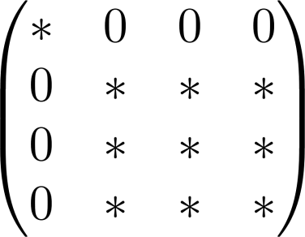
Irreducible Representaion and Character
Irreducible Representation $⇒$ minimum size rep.
If we can reduce the space of rep $⇒$ Reducible rep.
example for 3 D rotation ( 4 → 3 + 1)
Reducible rep. can be decomposed into irreducible rep.
Eigen functions are irreducible rep.
Character : Trace of representation matrix
Character of irreducible (reducible) rep.
( does not depend on the basis )
Character table : list of character for G_{P}

Slide 6
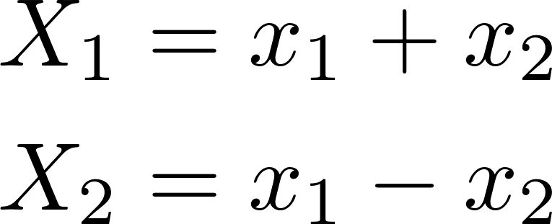
How to use character table
Character table : table of irreducible rep. for R and G
Example : mirror symmetry
Vibration of two particle $⇒$
＝１
＝－１
Atomic orbital
Symmetric
Anti- Symmetric

Slide 7
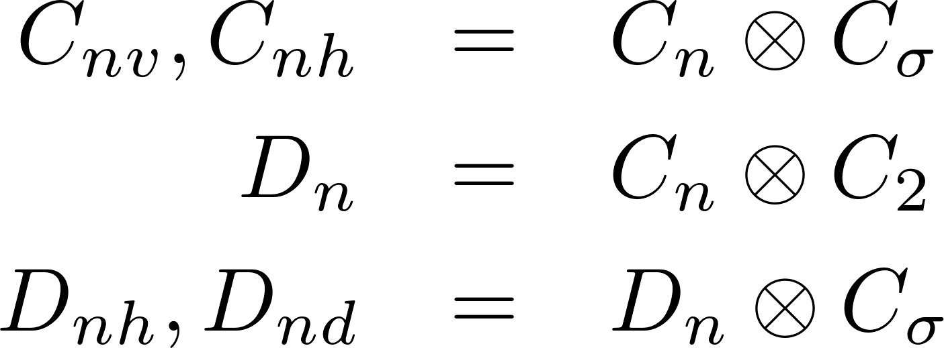
Family of Point Group
G that does not contain rotation
G that has a principle $n$-fold axis $Cn$
Mirror with Mirror
D_{n} with
Symmetry of regular polyhedron
N-fold Reflection symmetry
Ｓ

Slide 8
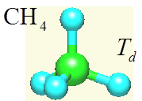
Atomic site Character χ_{a,s}
Molecular orbital (eigenfunctions) $⇒$ Irred.Rep (Ir. Rep)
How many MO`s in a Ir. Rep. ?
Number of MO can be obtained by χ_{as}
Definition χ_{as} $↔$ number of Invariant atoms for a given rotation
s orbital : χ_{as}
p orbitals :
χ_{as} or are reducible rep.
Decomposed into χ Ir. Rep $⇒$ See Example in next page
Why χ_{as} gives number of MO`s ?
Number of atoms that remain at diagonal matrix element of Rep. Matrix
Irred. Rep which belongs to {x,y,z}

Slide 9
Symmetry of CH₄ MO`s
CH₄ atomic orbitals C : (1S, 2S, 2P_{x} , 2P_{y}, 2P_{z}) 5
H: 1S x 4 → 9 MO`s
Point Groups of CH₄ (Td)
Number of electron = 10, HOMO = 5th MO
χ_{a,s} of C
χ_{a,s} of H

Slide 10
5 MO`s 3A₁+2T₂
MO-1 A1 C 1s Orbital
MO-2 A1 C 2s + H 1s orbitals
MO-3-5 T2 C (2s, 2p) + H 1s
(HOMO) (3-fold deg.)
MO`s are similar to AO`s
MO-1, MO-2, MO-3-5 are similar to 1s, 2s, 2p, respectively
4 sp³ bonding is not correct images
HOMO of CH₄ are 3-fold deg. $⇒$ stable molecule
Stability of a molecule $↔$ HOMO-LUMO gap
Charge distribution is similar to a sphere $⇒$ a quasi atom
Reduction of symmetry from GR $⇒$ Td
(rot. G) (Point G)
CH₄ full charge density
HOMO of CH₄
Space-filling model vs charge density

Slide 11
Optical Absorption and Emission
Symmetry of Matrix and Wavefunction
$↔$ even function in space
(Full symmetric)
Eigen energy can be obtained in Irred.Rep. Space
Optical absorption and emission ∝ Dipole moment vector $μ$
Ex. CH₄ MO`s
T2 $↔$ A1 allowed optical transition
contains A₁
O occupied (T₂) $⇒$ unoccupied (A₁)
X occupied (A₁) $⇒$ unoccupied (A₁)
X occupied (T₂) $⇒$ unoccupied (T₂)
T₂
XPS
UPS
A₁
LUMO
T₂
HOMO
A₁
A₁
C1s

Slide 12
Symmetry of Molecular Vibration
For mirror σ
σC_{n} → - C_{n}
Calculate number of normal mode by χ_{a,s}
Number of atoms $⇒$ 3 N freedom
$⇒$ decompose
Among 3N, 3 is translation ( )
Among 3N, 3 is rotation ( χ (axial vector) )
3N – 6 Freedom
(3N -5 for axial molecule )
3N – 6 Freedom $⇒$ Normal mode (Irred. Rep.)
Among them
χ (2nd rank ) $⇒$Raman active Mode
$xy, yz, x^{2} – y^{2}$etc $⇒$Polarization Tensor α
χ (x,y,z) $⇒$ Infra Red Active Mode $⇒$ $μ$
σC_{n} → - C_{n}

Slide 13
Vibration of CH₄ Molecule
⇒ Decompose
3N-6 freedom of vibration ⇒ Normal mode
Ex. CH₄ N = 5 , freedom of vibration 3N – 6 = 9 (Normal Modes)
Point Group (g=24)
Irreducible rep. for rotation
Irreducible rep. for translation
for CH₄ .
Reducible character for vibration
Raman Active :
3
IR Active :
2

Slide 14
IR Active and Raman Active
Point group without having inversion $I$ (such as $Td$)
Same Irred. rep. for IR and Raman is possible
For Point group with $I$
Each Irred. rep. is either even (g) or odd (u) for I
(g : gerade, u : ungerade)
IR and Raman active modes belong to different Ired.rep.
This is used for checking the existence of $I$

Slide 15
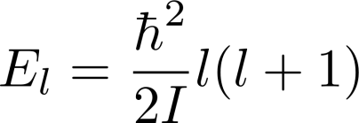
Rotation Motion of CH₄ Molecule
Molecule is rotating as a rigid molecule (Approx.)
Moment of Inertia (around center of mass)
Quantum angular momentum
degeneracy for a given state
(Spherical rotor ⇒ degeneracy)
4 H atoms are equivalent
Wave function for rotation motion ⇒ Symmetric for exchanging any of 2 H atoms
$A1$ symmetry only for rotational wave function
Red. Character of rotation ⇒ decomposition by $Td$
Representation of rotational group ⇒ $YLM$ (for a fixed axis)

Slide 16
Decomposition of Y_{LM}
Character is invariant for changing axis ⇒ z axis
L is invariant under changing axis
Eigenfunction for $L_{z}=M$
Rotation by $θ$ around z-axis : $R_{θ}⇒$ diagonal matrix
Example
Mirror
Inversion $I$
off diagonal
element
Only
Survives

Slide 17
Decomposition of Y_{LM} in T_{d}
For each L, reducible rep. is calculated ⇒ decomposition
L = 0
L = 1
L = 2
L = 3
Shottky abnormal
in specific heat
Rotation of CH₄ L = 0,3,… (L = 1,2 are forbidden)
Rotation of C₆₀ L = 0,6,… (L = 1,…5 are forbidden)
Degeneracy for $L=3$ of CH₄ is 1 ⇒ a large isotope effect for CH₃ D(C_{3V}),CH₂D₂(C_{2V}),etc

Slide 18
Projection Operator
We know how many Irred.Rep’s for each$Γ$
How to make a Molecule Orbital that belongs to $Γ$
When two MO’s belong to
Projection Operator
Ex.: A 2 atom molecule (H₂) (g=2,d=1)
For E,T Irred.Rep
⇒ We can use ij element rep. matrix
Same in the case of vibration

Slide 19
Summary
Definition of Group, Representation, Rep.Matrix, Character
Use of Symmetry by character table
Number of Irred.Rep in MO,Vib,Rot
Selection Rule of optical absorption and emission
Raman and IR active modes
Decomposition of Rotational group to Point group
Y_{LM} Td (Rotational mode selection)
Projection operator ⇒ Generation of MO in $Γ$

Slide 20
Problems
Select a molecule and examine the following facts
Point Group, Character Table, Number of MO in
Selection rule for optical absorption, Raman (IR) active modes
Compare with Gaussian results
Select any subjects of Group and discuss
Space Group (definition, How to use)
Symmetry Group
Learn following keywords and explain how to use
Irreducible tensor, spherical rotors, Young’s diagram, Dipole selection rule

