Slide 1
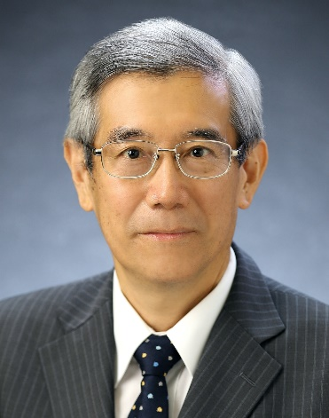
Practice with PC
Riichiro Saito
Department of Physics
National Taiwan Norma University
2024.3.11-5.9
Home
works
明白了！

Slide 2
Goal of this practice
(Overleaf) Share information and make homework online
(Paper) Practice for writing a scientific paper using overleaf
(Linux) Running Raman spectra by first-principles
You can do by
Word, Google docs, But too many limitation, not free of charge.
Excel or Origin, But the software is a blackbox.

Slide 3
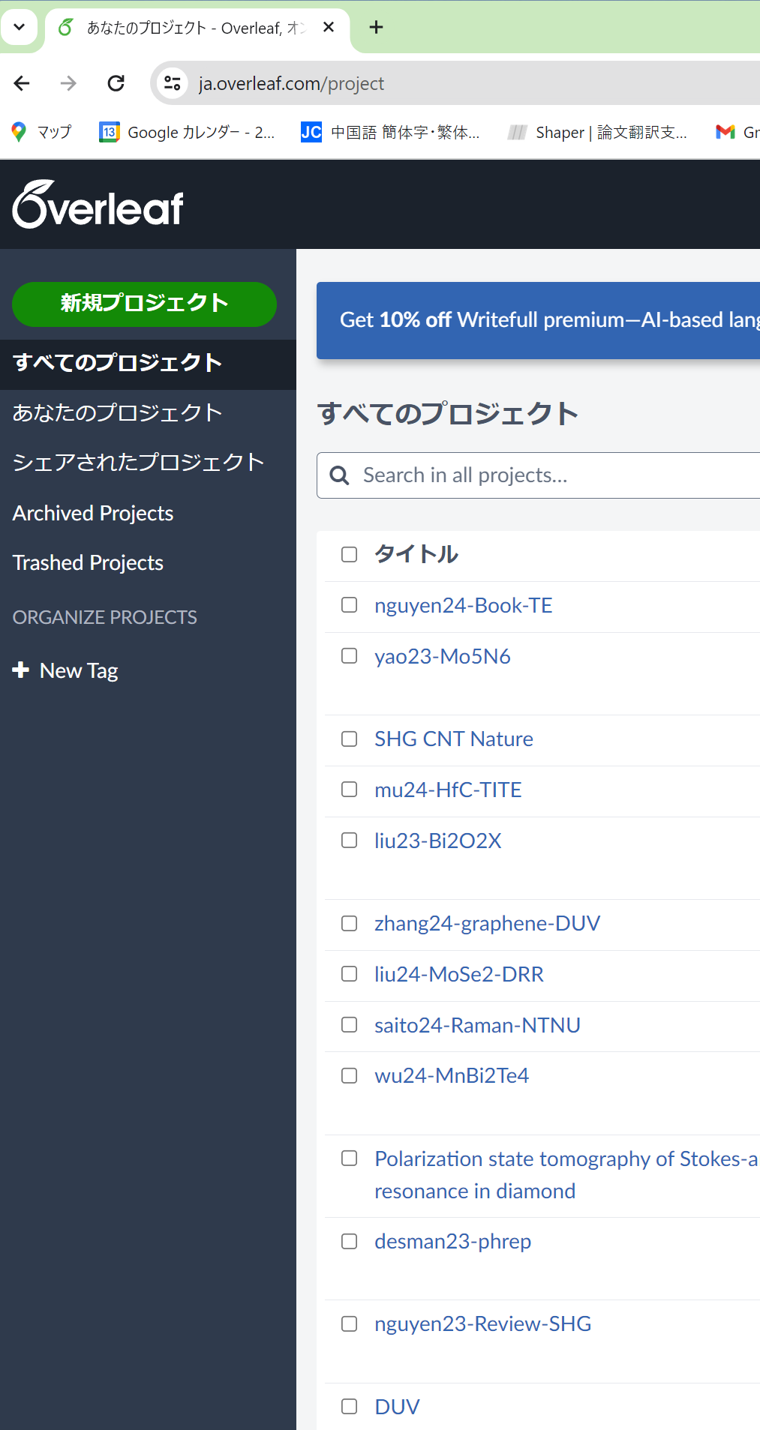
Let us use Overleaf and LaTeX !

Slide 4
Let us use Overleaf
Overleaf is online Editor of LaTeX. Free of Charge.
We can edit the file by several people at the same time.
Login overleaf and make a new project.
Let’s learn the basic LaTeX command and how to use it.
Let’s make a group project with two or three people.

Slide 5
Share information within the class !?
Find a problem (How to write equations, figures, tables)
Find a solution on the internet. Share your knowledges by overleaf.
If you do not find the solution, ask the community of the class.
If you do not find the answer, leave question or ask Saito.
If you find a problem or solution, please put on Overleaf.
We will make a project of overleaf for Q and A (question and answer)
You need to determine the format of the project.
Contribution to the overleaf is counted as Homework.

Slide 6
Basic rule for using Overleaf
file name : name-YYMMDD-subject.tex
Bad example: “test.tex”, “practice.tex”
Good example: “saito-240310-QA1.tex
show 5W1H: (who) makes (what) (when) for the reason (why) by (How)
Understand that everybody uses and reads the page.
simple and clear. Show definition and examples
do not use the subjective words “easy”, “great” etc.
Do not delete other inputs:
You can use \textcolor{red}{comments} for adding comment.
Only authors can accept or not the comment and delete it.

Slide 7
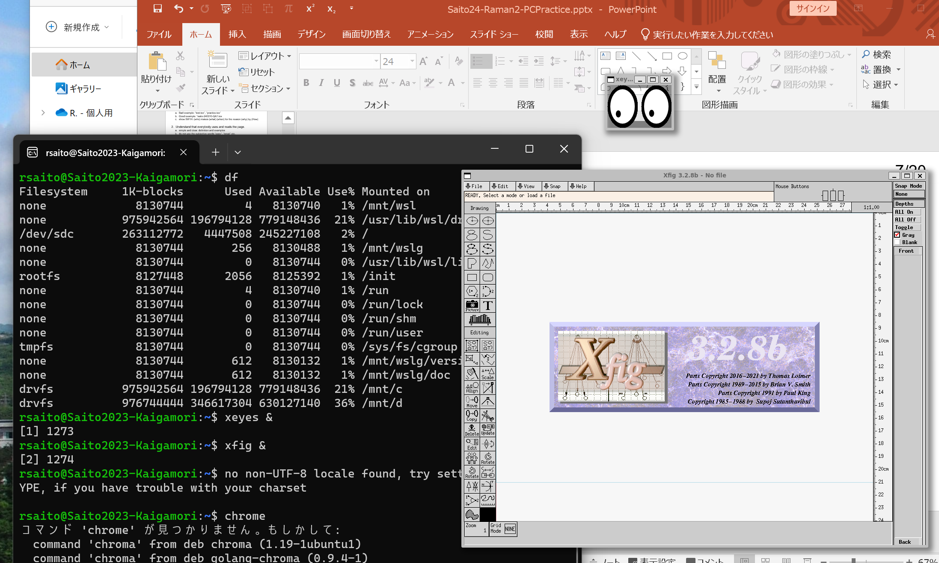
Let us use Ubuntu on Windows!

Slide 8
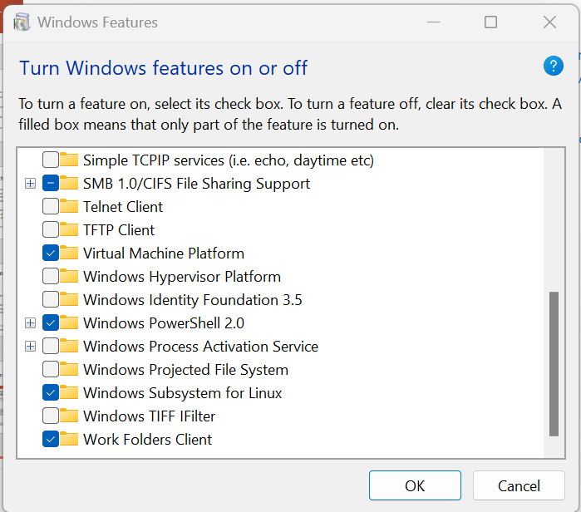
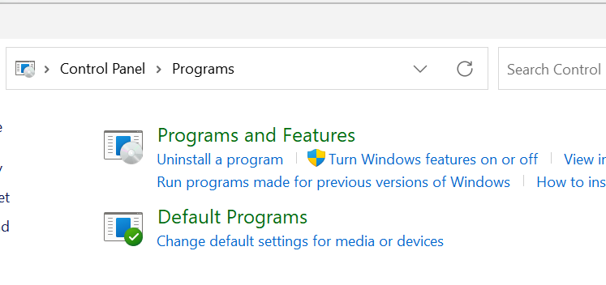
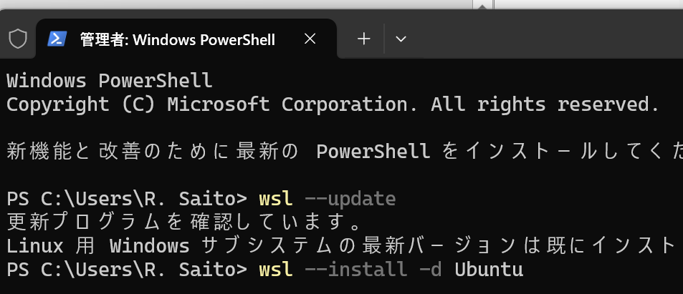
Install Windows Subsystem for Linux (WSL)
Step 1: Install WSL
Control Panel and click
Turn Windows features on or off
click box of
Windows Subsystem for Linux
Then select OK
Step 2: Press Window+X
select powershell as admin
> wsl --update > wsl –install –d Ubuntu
23/28

Slide 9
Start Ubuntu and install Quantum Espresso (QE)
Step 3: Start Ubuntu: and put username and password
NOTE: Typed password can not be seen.
Step 4: Install Quantum ESPRESSO (get installQE.sh for installation)
$ sudo apt –y update (you are asked password)
$ sudo apt –y upgrade $ sudo apt –y install quantum-espresso wannier90 (If you already installed them, they say “installed”)
$ sudo apt –y install git wget build-essential
$ sudo apt -y install xcrysden gnuplot
$ sudo apt -y install python3-dev python3-pip
$ pip3 install numpy scipy sympy
$ pip3 install matplotlib jupyterlab
$ echo ‘export PATH=“$HOME/.local/bin:$PATH”’ >> ~/.bashrc (Do not do this command twice)
$ source ~/.bashrc (No messages mean that it is a correct response.)
23/28

Slide 10
Step 2: Install Quantum ESPRESSO
Start Ubuntu and install Quantum Espresso (QE)
Step 3: Install Google-Chrome in Ubuntu
$ cd /tmp
$ wget https://dl.google.com/linux/direct/google-chrome-stable_current_amd64.deb $ sudo apt install --fix-missing ./google-chrome-stable_current_amd64.deb
$ google-chrome &
23/28

Slide 11
How to edit the file in Ubuntu
We will use editors (emacs, nano, vi, in Ubuntu or notepad in Windows )
$ nano (easy and quick)
$ emacs (Saito uses emacs for 40 years. sudo apt install emacs for installation)
Step 2: Installing Jupyter-lab in Ubuntu
$ sudo apt install xcrysden gnuplot font-manager
$ sudo apt install python3-dev python3-pip
$ pip3 install numpy scipy sympy
$ pip3 install matplotlib jupyterlab
$ echo ‘export PATH=“$HOME/.local/bin:$PATH”’ >> ~/.bashrc
$ which jupyter-lab
Errata of QE books can be seen in https://github.com/nguyen-group/QE-SSP/discussions/3
24/28

Slide 12
Let’s prepare software for non-resonant Raman
Step 1: Installing Google-Chrome in Ubuntu
$ cd /tmp
$ wget https://dl.google.com/linux/direct/google-chrome-stable_current_amd64.deb
$ sudo apt install --fix-missing ./google-chrome-stable_current_amd64.deb
$ google-chrome &
Step 2: Installing Jupyter-lab in Ubuntu
$ sudo apt install xcrysden gnuplot
$ sudo apt install python3-dev python3-pip
$ pip3 install numpy scipy sympy
$ pip3 install matplotlib jupyterlab
$ echo ‘export PATH=“$HOME/.local/bin:$PATH”’ >> ~/.bashrc
$ which jupyter-lab
Errata of QE books can be seen in https://github.com/nguyen-group/QE-SSP/discussions/3
24/28

Slide 13
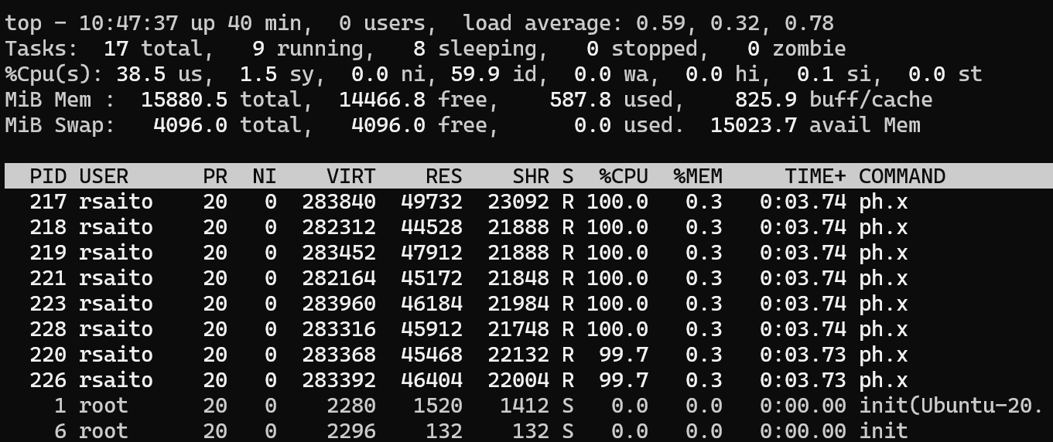
Let’s run run.sh for non-resonant Raman of MoS₂
Step 1: Run QE program for Raman
$ cd ~/QE-SSP/mos2/raman
$ notepad.exe ph.in & (Check if lraman = .true.)
$ nano run.sh (You can change “–np 4” to “-np 8” or “-np 2” depending on CPU)
$ (time ./run.sh) 2> time.out & (Run ob run.sh by measuring time. “./run.sh &” is also fine.)
$ top (We can check if 8 (or 4) pw.x and then ph.x is running.)
If Swap value is non-zero, you do not have sufficient memory.
Speed becomes very slow.
Change to a smaller value of –np.
You can stop top by press “q”
You can stop run.sh by “fg” and then
“control c”.
24/28

Slide 14
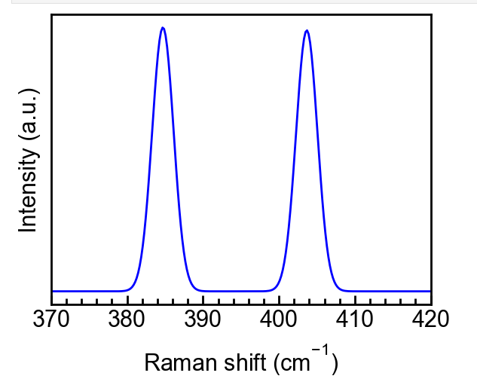
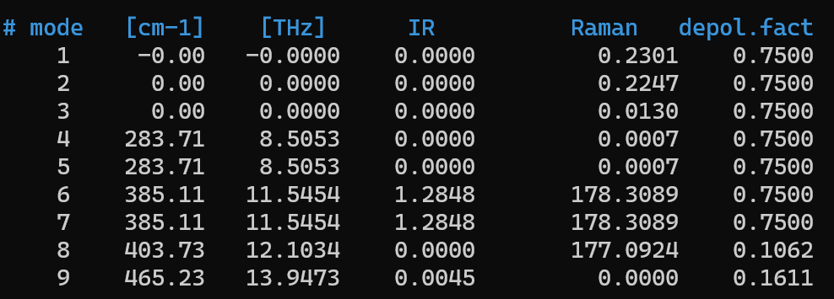
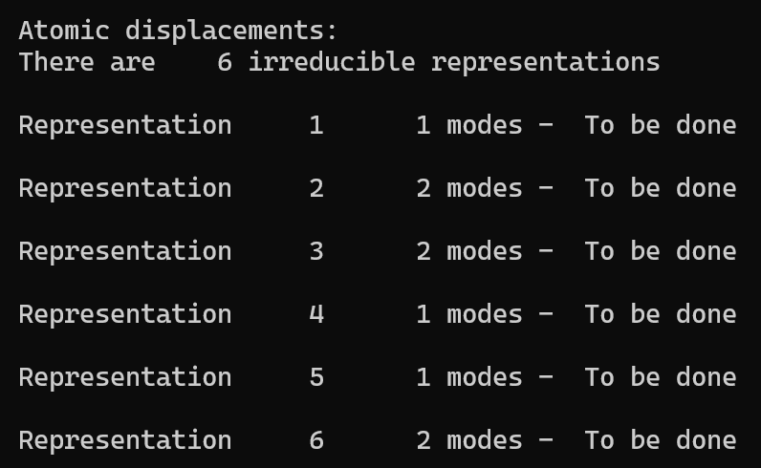
Show vibration of non-resonant Raman of MoS₂
Step 2: See phonon amplitude
jupyter-lab
$ jupyter-lab raman.ipynb &
$ nano dynmat.out
$ nano ph.out
dynmat.out
ph.out (Results of atomic sites)
A’1 + 2A’2 + 2A’’1 + A’’ + E’ + 2E’’
depol.factor = 0.75 means E mode
ph.out
We know irreducible representation of each Raman peak.
I : infrared absorption R: Raman
24/28

Slide 15
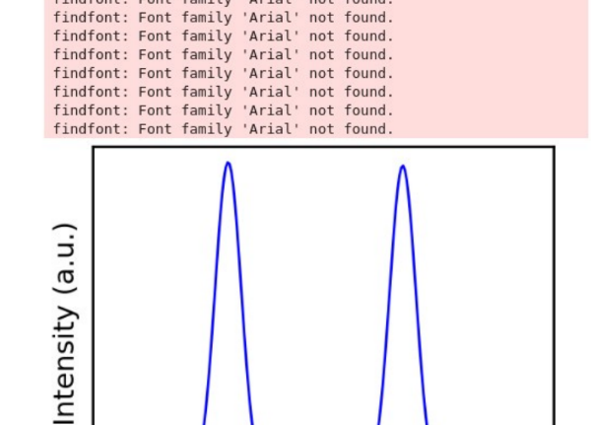
If Font family “Arial” not found appears,
$ sudo apt install ttf-mscorefonts-installer
$ fc-match Arial
$ sudo fc-cache -f –v
$ rm ~/.cache/matplotlib/fontlist-v300.json
https://scrapbox.io/programming-notes/findfont:_Font_family_%5B'Arial'%5D_not_found.

Slide 16
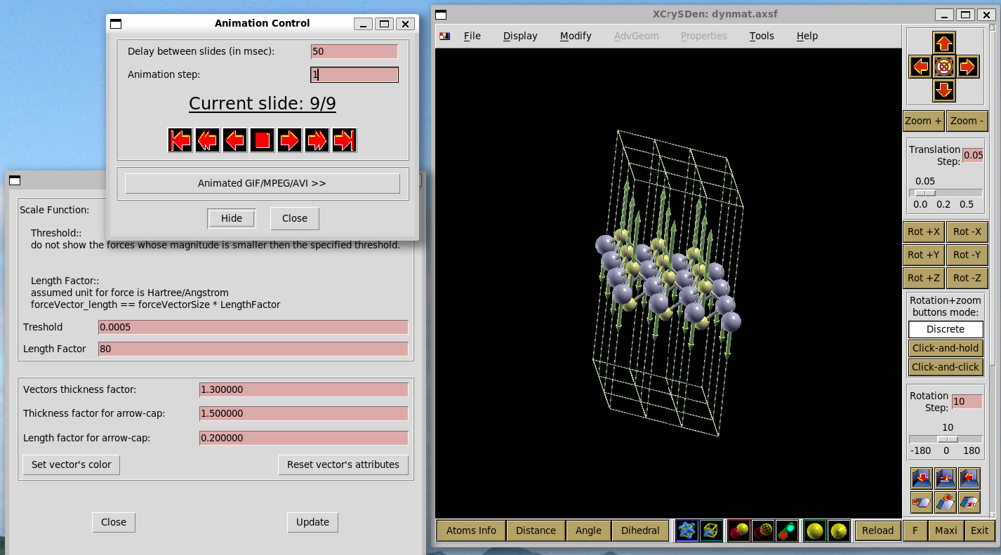
Visualization of vibration of MoS₂
Step 3: See phonon vibration using xcrysden
$ xcrysden &
1. File -> open structure ->
Open AXSF -> dynmat.axsf
2. Modify -> Number of Units Drawn
-> 3, 3, 1 ok
3. Display -> select Forces
you can see arrows
4. Modify -> Force setting ->
length factor 80
24/28

Slide 17
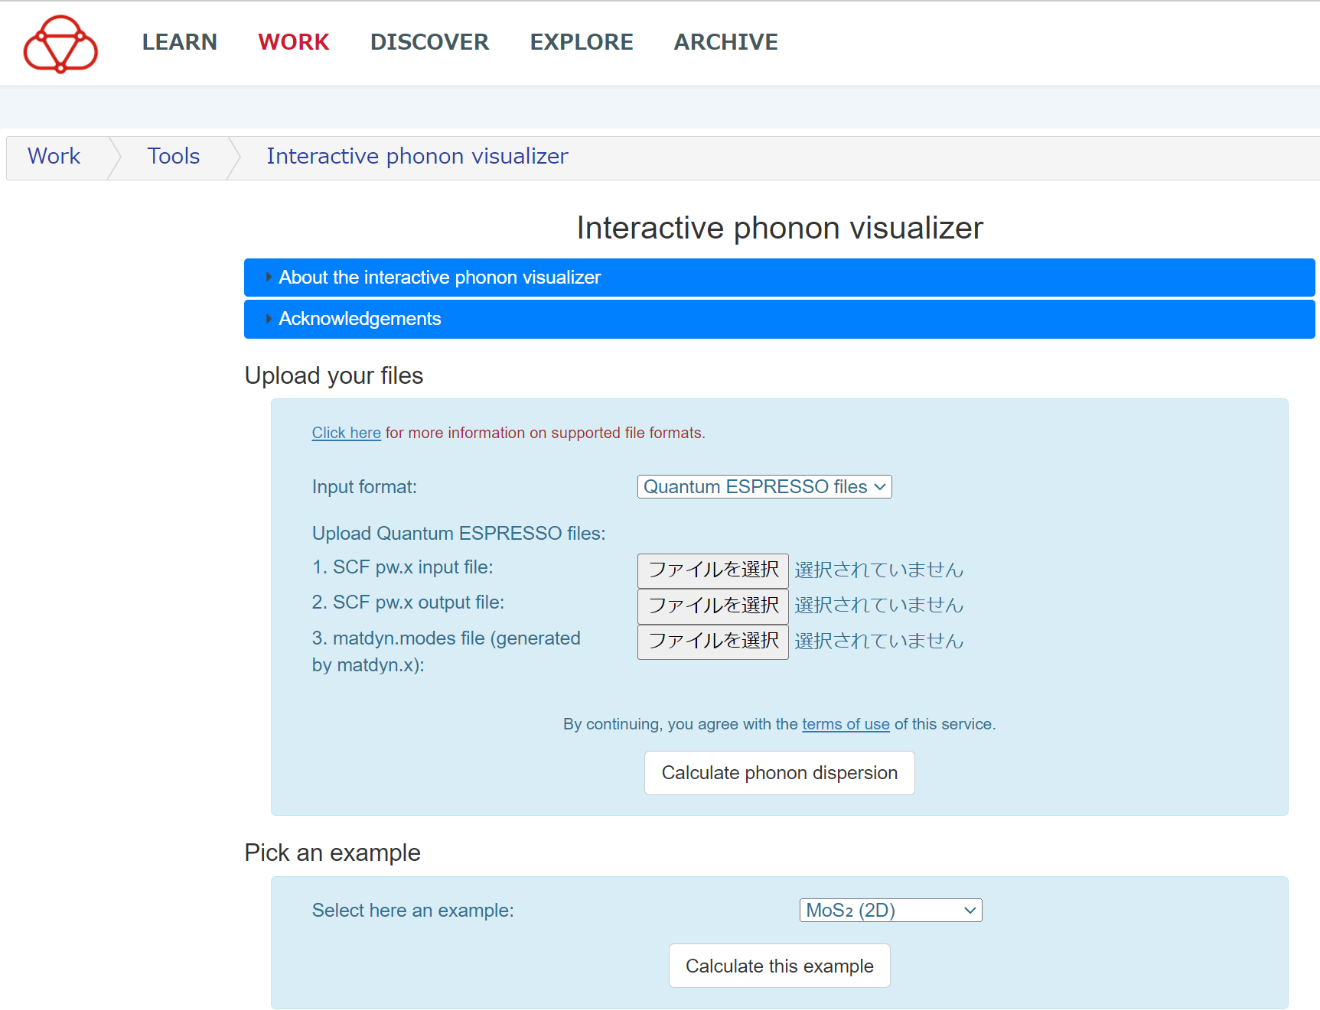
Animation of vibration by Materialscloud of MoS₂
Step 4: https://interactivephonon.materialscloud.io/
Pickup an example (bottom) -> Select MoS2 (2D) -> Calculate this example
Select Gamma point phonon such as 283 cm-1
24/28

Slide 18
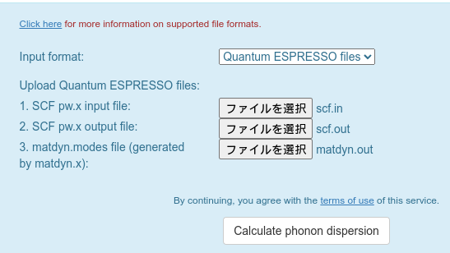
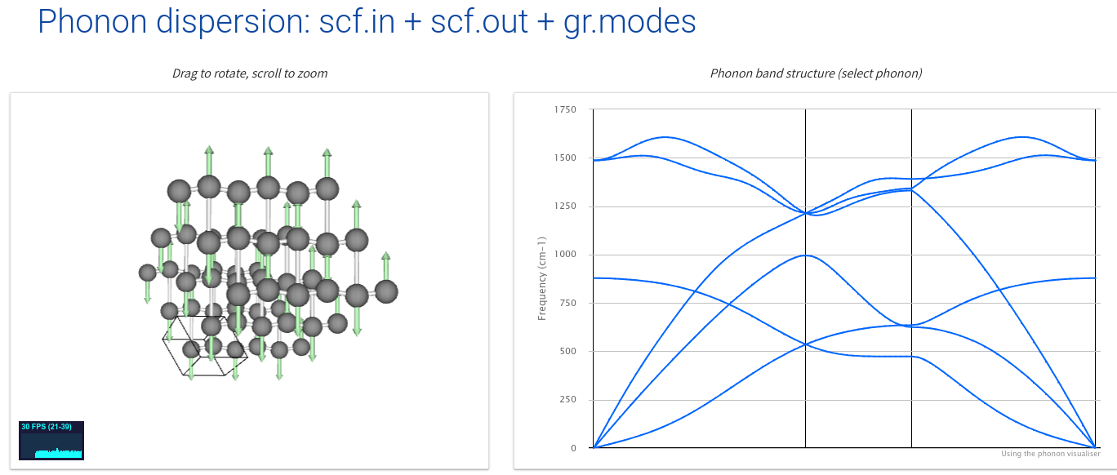
Do you want your results in Animation?
Step 5: Let us calculate phonon dispersion of graphene
$ cd ~/QESSP/gr/phonon
$ nano run.sh (You can change to “-np 8”)
$ (time ./run.sh) 2> time.out & (Run job it takes 12min)
$ top f
$ jupyter-lab plot-phonon.ipynb &
(You can see phonon dispersion)
$ google-chrome https://interactivephonon.materialscloud.io/ &
1. select scf.in
2. select scf.out
3. select gr.modes
push button
"Calculate ... dispersion"
24/28

Slide 19
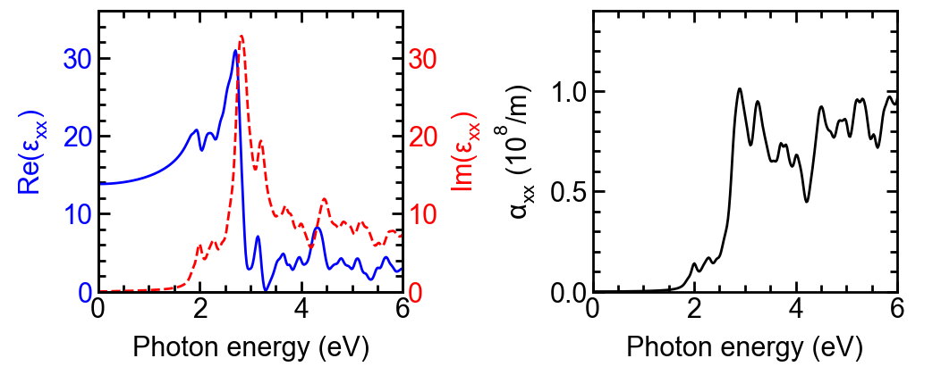
Calculate dielectric function and optical absorption MoS₂
Step 1: Run QE program for Raman
%
% 10. Calculate dielectric function
%
cd QE-SSP/mos2/optic/
nano run.sh (Change to "-np 8" if CPU has a power.)
(time ./run.sh) 2> time.out & (Run the job. It takes 18 mins)
top (You can check how jobs are running.)
jupyter-lab eps.ipynb & (Plot dielectric function and optical absorption.)
24/28

Slide 20
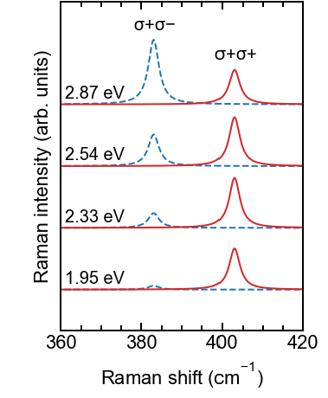
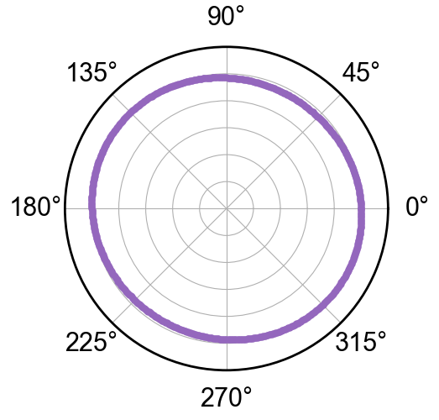
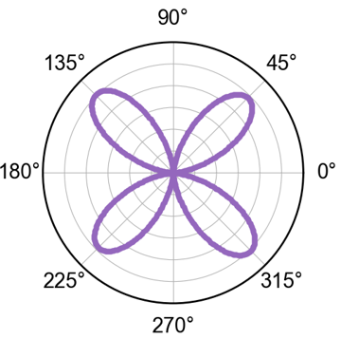
Calculate Resonance Raman spectra of MoS₂
Step 1: Run command in 11. of installQE.sh
11-1 install fortran compiler
11-2 install QERaman in ~/opt/q-e
11-3 Change PATH in ~/.bashrc
11-4 Calculate MoS2 resonance Raman spectra
cd ~/opt/q-e/QERaman/example/mos2
nano run.sh (Change from "-np 48" to "-np 8" or "-np 4")
nano scf.in (Change k point mesh from 48x48x1 to 12x12x1)
(time ./run.sh) 2> time.out & (Run the job. It takes 12 mins)
top
cp reference/*.ipynb .
cp reference/sci.mplstyle .
jupyter-lab plot-raman-spectra.ipynb
jupyter-lab plot-raman-polar.ipynbj (Change plt.polar(i, IRaman),R1, to R2 or R3)
24/28

Slide 21
Advanced Work for Your Research
You can learn more Quantum Espresso (QE)
in September!!
Basic knowledge of input and output files of QE.
Basic knowledge of density-functional theory in QE.
How to make the input files for new materials.
If you can not wait September, you can learn from our book.
Ask your professor to buy the book or find pdf file.
All the contents are based on the examples.

