Slide 1
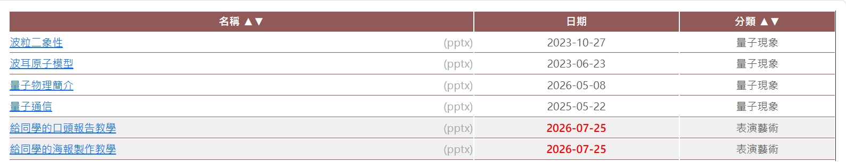
Scientific PPT
web.phy.ntnu.edu.tw/~hongyi/?url=education

Slide 2

Scientific PPT
封面
目錄
實驗目的
實驗設置
1
2
3
4
實驗結果1與討論1
實驗結果2與討論2
結論
致謝
5
6
7
8

Slide 3
封面
題目
指導老師：姓名
組員：姓名
日期

Slide 4
目錄
目的
實驗設置
實驗結果與討論
結論
致謝

Slide 5
實驗目的
實驗目的
例如：
我想要探究XX和YY的關係。
實驗動機(不要寫，在封面頁和題目一起講)
例如：
我為什麼想要做這一個實驗

Slide 6
實驗方法
描述實驗步驟並且附上照片

Slide 7
實驗結果與討論
長篇文字
圖表設計

Slide 8
結論
條列說明
我們發現…..
我們發現…..

Slide 9
致謝
心得(不要寫,在致謝頁和感謝詞一起講)
感謝合作團隊
參考文獻

Slide 10
目錄頁設計
難以理解的段落
無章節頁分段
因中間不能理解，
而聽不懂後面的內容
理解停損點
有章節頁分段
之後章節，聽眾可以重新跟上

Slide 11
修改前
大綱
(1) 產品銷售情形及未來業務發展計畫
(2) 未來營運資金來源及規劃

Slide 12
方法一
章節即目錄
複製目錄頁，
當作不同章節的章節頁
1. 產品銷售情形及未來業務發展計畫
2. 未來營運資金來源及規劃

Slide 13
方法二
圖像化
把文字作
圖像化式的思考
大小
位置＋線條
用大小對比
凸顯重點
用位置及線條
表現邏輯

Slide 14
修改後
大綱
Part 1
產品
Part 2
資金
產品銷售情形及
未來業務發展計畫
未來營運資金
來源及規劃

Slide 15
長篇文字
圖表設計

Slide 16
修改前
New York Times History
The New York Times was founded as the New-York Daily Times on September 18, 1851, by journalist and politician Henry Jarvis Raymond (1820–69), then a Whig Party member and later second chairman of the newly organized Republican Party National Committee, and former banker George Jones. Sold for a penny (equivalent to 28 cents today), the inaugural edition attempted to address various speculations on its purpose and positions that preceded its release. The newspaper shortened its name to The New-York Times in 1857. It dropped the hyphen in the city name in the 1890s. On April 21, 1861, The New York Times departed from its original Monday–Saturday publishing schedule and joined other major dailies in adding a Sunday edition to offer daily coverage of the Civil War. One of the earliest public controversies it was involved with was the Mortara Affair, the subject of twenty editorials it published alone.

Slide 17
方法一
重點提示
把重要的文字標示
粗體、底線或改顏色
New York Times History
The New York Times was founded as the New-York Daily Times on September 18, 1851, by journalist and politician Henry Jarvis Raymond (1820–69), then a Whig Party member and later second chairman of the newly organized Republican Party National Committee, and former banker George Jones. Sold for a penny (equivalent to 28 cents today), the inaugural edition attempted to address various speculations on its purpose and positions that preceded its release. The newspaper shortened its name to The New-York Times in 1857. It dropped the hyphen in the city name in the 1890s. On April 21, 1861, The New York Times departed from its original Monday–Saturday publishing schedule and joined other major dailies in adding a Sunday edition to offer daily coverage of the Civil War. One of the earliest public controversies it was involved with was the Mortara Affair, the subject of twenty editorials it published alone.

Slide 18
方法二
簡化
把細節刪減
分項呈現
New York Times History
New York Daily Times
September 18, 1851
Henry Jarvis Raymond, George Jones
Adding a Sunday edition on April 21, 1861

Slide 19
方法三
圖示
使用向量圖示
把資訊視覺化
New York Times History
New York Daily Times
Henry Jarvis Raymond
George Jones

Slide 20
重點提示
把重要的文字標示
粗體、底線或改顏色
簡化
把細節刪減
分項呈現
圖示
使用向量圖示
把資訊視覺化
版面變得更加
花俏不易閱讀
只能自己使用
耗時費力且意思
表達不容易精確

Slide 21
方法四
圖像化
把文字作
圖像化式的思考
大小
位置＋線條
用大小對比
凸顯重點
用位置及線條
表現邏輯

Slide 22
修改前
修改後
The New York Times was founded as the New-York Daily Times on September 18, 1851, by journalist and politician Henry Jarvis Raymond (1820–69), then a Whig Party member and later second chairman of the newly organized Republican Party National Committee, and former banker George Jones. Sold for a penny (equivalent to 28 cents today), the inaugural edition attempted to address various speculations on its purpose and positions that preceded its release. The newspaper shortened its name to The New-York Times in 1857. It dropped the hyphen in the city name in the 1890s. On April 21, 1861, The New York Times departed from its original Monday–Saturday publishing schedule and joined other major dailies in adding a Sunday edition to offer daily coverage of the Civil War. One of the earliest public controversies it was involved with was the Mortara Affair, the subject of twenty editorials it published alone.
The New York Times
The past, the present, and the future
The New York Times was founded as the New-York Daily Times on September 18, 1851, by journalist and politician Henry Jarvis Raymond (1820–69), then a Whig Party member and later second chairman of the newly organized Republican Party National Committee, and former banker George Jones. Sold for a penny (equivalent to 28 cents today), the inaugural edition attempted to address various speculations on its purpose and positions that preceded its release. The newspaper shortened its name to The New-York Times in 1857. It dropped the hyphen in the city name in the 1890s. On April 21, 1861, The New York Times departed from its original Monday–Saturday publishing schedule and joined other major dailies in adding a Sunday edition to offer daily coverage of the Civil War. One of the earliest public controversies it was involved with was the Mortara Affair, the subject of twenty editorials it published alone.

Slide 23
修改前
傳統條列式方法
New York Daily Times
September 18, 1851
Henry Jarvis Raymond, George Jones
Adding a Sunday edition on April 21, 1861
用位置與線條強調邏輯
修改後
Henry J. Raymond
The New York Sun
The New York Herald
The New York Tribune
George Jones
Adolph Ochs
Online services
靈活改變位置並加
入輔助線條或圖案

Slide 24
修改前
New York Times History
The New York Times was founded as the New-York Daily Times on September 18, 1851, by journalist and politician Henry Jarvis Raymond (1820–69), then a Whig Party member and later second chairman of the newly organized Republican Party National Committee, and former banker George Jones. Sold for a penny (equivalent to 28 cents today), the inaugural edition attempted to address various speculations on its purpose and positions that preceded its release. The newspaper shortened its name to The New-York Times in 1857. It dropped the hyphen in the city name in the 1890s. On April 21, 1861, The New York Times departed from its original Monday–Saturday publishing schedule and joined other major dailies in adding a Sunday edition to offer daily coverage of the Civil War. One of the earliest public controversies it was involved with was the Mortara Affair, the subject of twenty editorials it published alone.

Slide 25
修改後
The New York Times
The past, the present, and the future
Raymond
Post Raymond
The New York Times was founded as the New-York Daily Times on September 18, 1851, by journalist and politician Henry Jarvis Raymond (1820–69), then a Whig Party member and later second chairman of the newly organized Republican Party National Committee, and former banker George Jones. Sold for a penny (equivalent to 28 cents today), the inaugural edition attempted to address various speculations on its purpose and positions that preceded its release. The newspaper shortened its name to The New-York Times in 1857. It dropped the hyphen in the city name in the 1890s.
Adolph Ochs
On April 21, 1861, The New York Times departed from its original Monday–Saturday publishing schedule and joined other major dailies in adding a Sunday edition to offer daily coverage of the Civil War. One of the earliest public controversies it was involved with was the Mortara Affair, the subject of twenty editorials it published alone.

Slide 26
修改後II
The New York Times
The past, the present, and the future
Raymond
Post Raymond
Adolph Ochs

Slide 27
修改後III
The New York Times was founded as the New-York Daily Times on September 18, 1851, by journalist and politician Henry Jarvis Raymond (1820–69), then a Whig Party member and later second chairman of the newly organized Republican Party National Committee, and former banker George Jones. Sold for a penny (equivalent to 28 cents today), the inaugural edition attempted to address various speculations on its purpose and positions that preceded its release. The newspaper shortened its name to The New-York Times in 1857. It dropped the hyphen in the city name in the 1890s. On April 21, 1861, The New York Times departed from its original Monday–Saturday publishing schedule and joined other major dailies in adding a Sunday edition to offer daily coverage of the Civil War. One of the earliest public controversies it was involved with was the Mortara Affair, the subject of twenty editorials it published alone. The New York Times was founded as the New-York Daily Times on September 18, 1851, by journalist and politician Henry Jarvis Raymond (1820–69), then a Whig Party member and later second chairman of the newly organized Republican Party National Committee, and former banker George Jones. Sold for a penny (equivalent to 28 cents today), the inaugural edition attempted to address various speculations on its purpose and positions that preceded its release. The newspaper shortened its name to The New-York Times in 1857. It dropped the hyphen in the city name in the 1890s. On April 21, 1861, The New York Times departed from its original Monday–Saturday publishing schedule and joined other major dailies in adding a Sunday edition to offer daily coverage of the Civil War. One of the earliest public controversies it was involved with was the Mortara Affair, the subject of twenty editorials it published alone. The New York Times was founded as the New-York Daily Times on September 18, 1851, by journalist and politician Henry Jarvis Raymond (1820–69), then a Whig Party member and later second chairman of the newly organized Republican Party National Committee, and former banker George Jones. Sold for a penny (equivalent to 28 cents today), the inaugural edition attempted to address various speculations on its purpose and positions that preceded its release. The newspaper shortened its name to The New-York Times in 1857. It dropped the hyphen in the city name in the 1890s. On April 21, 1861, The New York Times departed from its original Monday–Saturday publishing schedule and joined other major dailies in adding a Sunday edition to offer daily coverage of the Civil War. One of the earliest public controversies it was involved with was the Mortara Affair, the subject of twenty editorials it published alone. The New York Times was founded as the New-York Daily Times on September 18, 1851, by journalist and politician Henry Jarvis Raymond (1820–69), then a Whig Party member and later second chairman of the newly organized Republican Party National Committee, and former banker George Jones. Sold for a penny (equivalent to 28 cents today), the inaugural edition attempted to address various speculations on its purpose and positions that preceded its release. The newspaper shortened its name to The New-York Times in 1857. It dropped the hyphen in the city name in the 1890s. On April 21, 1861, The New York Times departed from its original Monday–Saturday publishing schedule and joined other major dailies in adding a Sunday edition to offer daily coverage of the Civil War. One of the earliest public controversies it was involved with was the Mortara Affair, the subject of twenty editorials it published alone. The New York Times was founded as the New-York Daily Times on September 18, 1851, by journalist and politician Henry Jarvis Raymond (1820–69), then a Whig Party member and later second chairman of the newly organized Republican Party National Committee, and former banker George Jones. Sold for a penny (equivalent to 28 cents today), the inaugural edition attempted to address various speculations on its purpose and positions that preceded its release. The newspaper shortened its name to The New-York Times in 1857. It dropped the hyphen in the city name in the 1890s. On April 21, 1861, The New York Times departed from its original Monday–Saturday publishing schedule and joined other major dailies in adding a Sunday edition to offer daily coverage of the Civil War. One of the earliest public controversies it was involved with was the Mortara Affair, the subject of twenty editorials it published alone. The New York Times was founded as the New-York Daily Times on September 18, 1851, by journalist and politician Henry Jarvis Raymond (1820–69), then a Whig Party member and later second chairman of the newly organized Republican Party National Committee, and former banker George Jones. Sold for a penny (equivalent to 28 cents today), the inaugural edition attempted to address various speculations on its purpose and positions that preceded its release. The newspaper shortened its name to The New-York Times in 1857. It dropped the hyphen in the city name in the 1890s. On April 21, 1861, The New York Times departed from its original Monday–Saturday publishing schedule and joined other major dailies in adding a Sunday edition to offer daily coverage of the Civil War. One of the earliest public controversies it was involved with was the Mortara Affair, the subject of twenty editorials it published alone. The New York Times was founded as the New-York Daily Times on September 18, 1851, by journalist and politician Henry Jarvis Raymond (1820–69), then a Whig Party member and later second chairman of the newly organized Republican Party National Committee, and former banker George Jones. Sold for a penny (equivalent to 28 cents today), the inaugural edition attempted to address various speculations on its purpose and positions that preceded its release. The newspaper shortened its name to The New-York Times in 1857. It dropped the hyphen in the city name in the 1890s. On April 21, 1861, The New York Times departed from its original Monday–Saturday publishing schedule and joined other major dailies in adding a Sunday edition to offer daily coverage of the Civil War. One of the earliest public controversies it was involved with was the Mortara Affair, the subject of twenty editorials it published alone. The New York Times was founded as the New-York Daily Times on September 18, 1851, by journalist and politician Henry Jarvis Raymond (1820–69), then a Whig Party member and later second chairman of the newly organized Republican Party National Committee, and former banker George Jones. Sold for a penny (equivalent to 28 cents today), the inaugural edition attempted to address various speculations on its purpose and positions that preceded its release. The newspaper shortened its name to The New-York Times in 1857. It dropped the hyphen in the city name in the 1890s. On April 21, 1861, The New York Times departed from its original Monday–Saturday publishing schedule and joined other major dailies in adding a Sunday edition to offer daily coverage of the Civil War. One of the earliest public controversies it was involved with was the Mortara Affair, the subject of twenty editorials it published alone. The New York Times was founded as the New-York Daily Times on September 18, 1851, by journalist and politician Henry Jarvis Raymond (1820–69), then a Whig Party member and later second chairman of the newly organized Republican Party National Committee, and former banker George Jones. Sold for a penny (equivalent to 28 cents today), the inaugural edition
The New York Times
The past, the present, and the future
Raymond
Post Raymond
Adolph Ochs

Slide 28
練習
https://shorturl.at/FdxMf

Slide 29
修改前
背景說明
對兒童來說，國內不施行心肺復甦術的醫囑通常在下列時機下簽暑：
(1)在醫生的判斷裡，使孩子延長生命的治癒性的治療對孩子沒有益處。
(2)父母認為兒童因心肺復甦術而受苦，基於兒童的最大利益，心肺復甦術應不被直行或應中止。

Slide 30
修改後
背景說明
對兒童來說，國內不施行心肺復甦術的醫囑通常在下列時機下簽暑：
1. 醫生急救無效
2. 父母放棄治療
在醫生的判斷裡，使孩子延長生命的治癒性的治療對孩子沒有益處。
父母認為兒童因心肺復甦術而受苦，基於兒童的最大利益，心肺復甦術應不被直行或應中止。

Slide 31
長篇文字
圖表設計

Slide 32
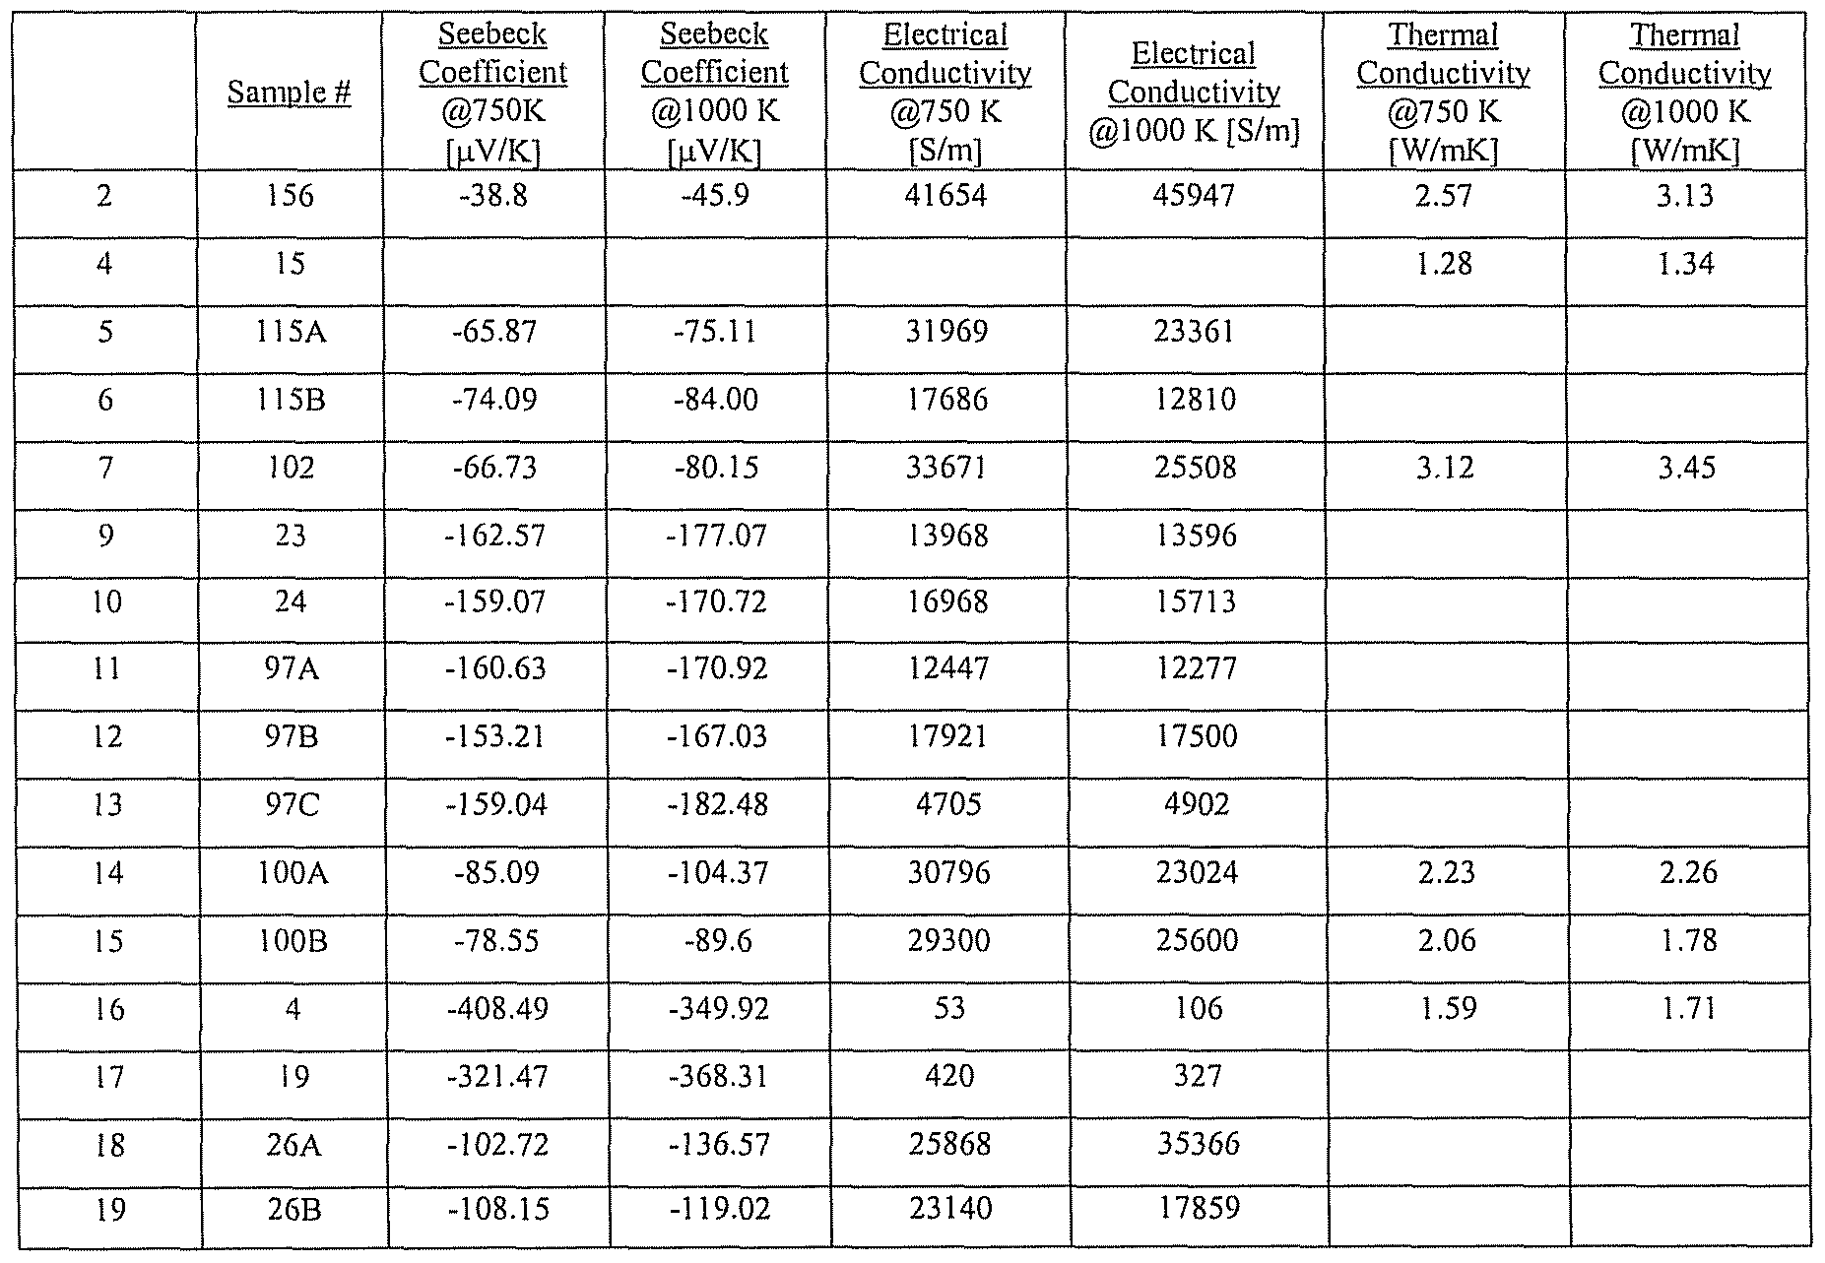
方法一
凸顯資訊

Slide 33
方法二
凸顯資訊

Slide 34
方法三
降低雜訊

Slide 35
方法四
放大鏡

Slide 36
練習
https://shorturl.at/FXpYJ

Slide 37
組合技

Slide 38
修改前
數目
月份

Slide 39
修改後一
數目
月份

Slide 40
修改後二
數目
月份

Slide 41
動畫設計

Slide 42
987654321
987654321
0
987654321
0
1
1
0
98765432
1
動圖使用原則
需要重點強調的
數據、現象、方法
0
熱情

Slide 43
過多動畫for Science

Slide 44
簡易編排原則

Slide 45
字型
標題
內文
  36-44pt，不超過2行
中文: 微軟正黑體
英文: Arial，Calibri，CMU Sans Serif
20-25pt
中文:微軟正黑體或標楷體
英文: Courier New，Georgia，Times New Roman，CMU Serif
Comic Sans
華康秀麗體或少女體
Times New Roman
新細明體
你覺得自己很有趣
表示你很懶惰
Courier New
標楷體
表示你是個有組織、嚴謹的人

Slide 46
保留PPT上參考資料空間
內容
參考
資料
底部保留1cm高度，以利放入參考資料 (16pt大小文字)

Slide 47
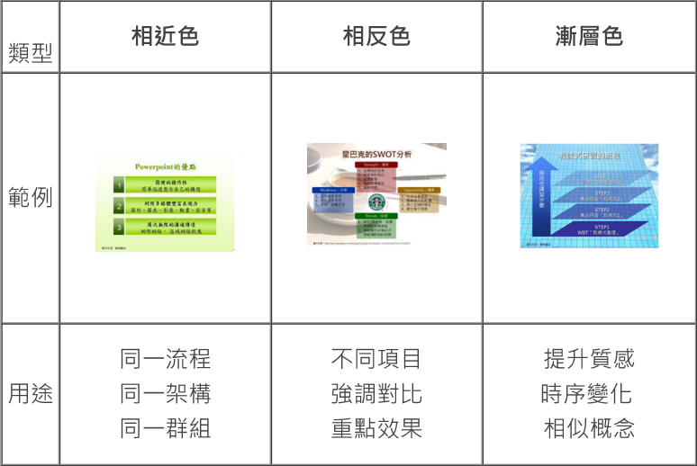
常用配色法

